Slide 1
Functional dependency

Slide 2
Functional dependency
Functional dependency defines relationship among attributes of a relation schema.
It typically exists between the primary key and non-key attribute within a table.
It is denoted as X → Y, where the attribute set on the left side of the arrow, X is called Determinant, and Y is called the Dependent.
Formal Definition:
If R be a relation schema and X and Y are two subsets of R then we say that X functionally determines Y (X → Y) if for any pair of tuple t1 and t2 belonging to any state r(R) whenever t1[X] = t2[X], we must have t1[Y]=t2[Y]

Slide 3
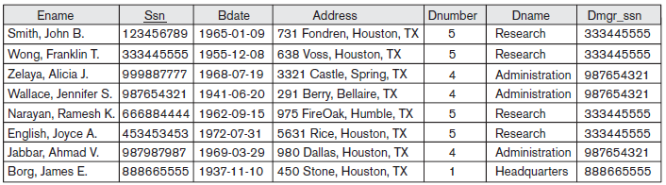
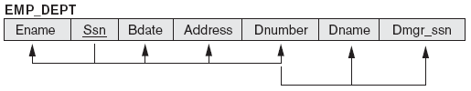
{Ssn} → {Ename, Bdate, Address, Dnumber}
{Dnumber} → {Dname, Dmgr_ssn}

Slide 4
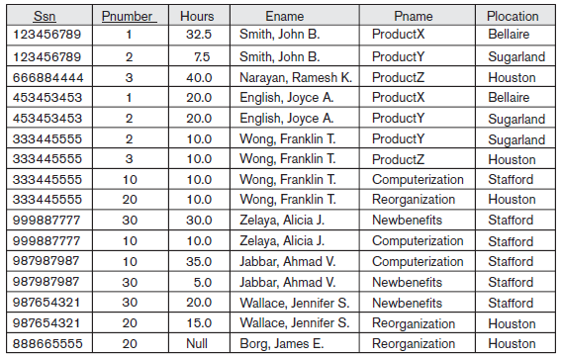

Slide 5
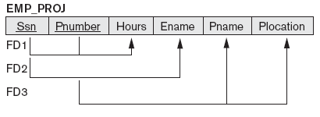
FD1: {Ssn, Pnumber} → {Hours}
FD2: {Ssn} → {Ename}
FD3: {Pnumber} → {Pname, Plocation}

Slide 6
Armstrong’s rules (axioms)
Assume that R is a relation schema and X, Y and Z are subsets of R.
Reflexivity rule: If X is a super set of Y then X → Y.
Augmentation rule: If X → Y then XZ → YZ.
Transitivity rule: If X → Y & Y → Z then X → Z.

Slide 7
Additional rules
Union rule: If X → Y and X → Z then X → YZ
Decomposition rule: If X → YZ then X → Y and X → Z
Pseudo transitivity rule: If X → Y and YZ → V then XZ → V
Composition rule: If X → Y and V → W then XV → YW
Self Determination: It is similar to the Axiom of Reflexivity, i.e. A→A for any A.
Extensivity: Extensivity is a case of augmentation. If AC→A, and A→B, then AC→B. Similarly, AC→ABC and ABC→BC. This leads to AC→BC.

Slide 8
Types of Functional Dependencies in DBMS
Trivial functional dependency
Non-Trivial functional dependency
Multivalued functional dependency
Transitive functional dependency

Slide 9
Trivial functional dependency
In Trivial Functional Dependency, a dependent is always a subset of the determinant. i.e. If X → Y and Y is the subset of X, then it is called trivial functional dependency.
Example:
Here, {roll_no, name} → name is a trivial functional dependency, since the dependent name is a subset of determinant set {roll_no, name}. Similarly, roll_no → roll_no is also an example of trivial functional dependency.
Roll_no | name | age
42 | abc | 17
43 | pqr | 18
44 | abc | 18

Slide 10
Non-trivial Functional Dependency
In Non-trivial functional dependency, the dependent is strictly not a subset of the determinant. i.e. If X → Y and Y is not a subset of X, then it is called Non-trivial functional dependency.
Here, roll_no → name is a non-trivial functional dependency, since the dependent name is not a subset of determinant roll_no. Similarly, {roll_no, name} → age is also a non-trivial functional dependency, since age is not a subset of {roll_no, name}

Slide 11
Multivalued Functional Dependency
In Multivalued functional dependency, entities of the dependent set are not dependent on each other. i.e. If a → {b, c} and there exists no functional dependency between b and c, then it is called a multivalued functional dependency.
Example:
Here, roll_no → {name, age} is a multivalued functional dependency, since the dependents name & age are not dependent on each other(i.e. name → age or age → name doesn’t exist !)
roll_no | name | age
42 | abc | 17
43 | pqr | 18
44 | xyz | 18
45 | abc | 19

Slide 12
Transitive Functional Dependency
In transitive functional dependency, dependent is indirectly dependent on determinant. i.e. If a → b & b → c, then according to axiom of transitivity, a → c. This is a transitive functional dependency.
Example:
Here, enrol_no → dept and dept → building_no.
Hence, according to the axiom of transitivity, enrol_no → building_no is a valid functional dependency.
This is an indirect functional dependency, hence called Transitive functional dependency.
enrol_no | name | dept | building_no
42 | abc | CO | 4
43 | pqr | EC | 2
44 | xyz | IT | 1
45 | abc | EC | 2

Slide 13
Fully Functional Dependency
In full functional dependency an attribute or a set of attributes uniquely determines another attribute or set of attributes. If a relation R has attributes X, Y, Z with the dependencies X->Y and X->Z which states that those dependencies are fully functional.
Partial Functional Dependency
In partial functional dependency a non key attribute depends on a part of the composite key, rather than the whole key. If a relation R has attributes X, Y, Z where X and Y are the composite key and Z is non key attribute. Then X->Z is a partial functional dependency in RBDMS.

